Slide 1
Robotics and IoT Club Secondary Years Level 2 - Week 5
Roohi Banu

Slide 2
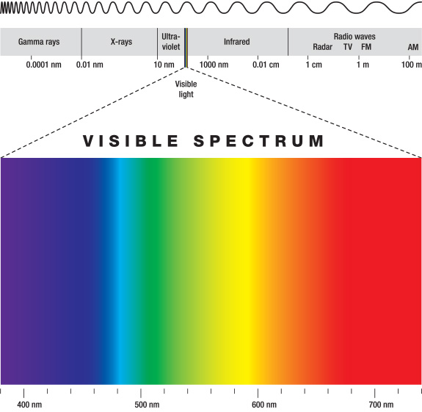
Radio Frequency

Slide 3
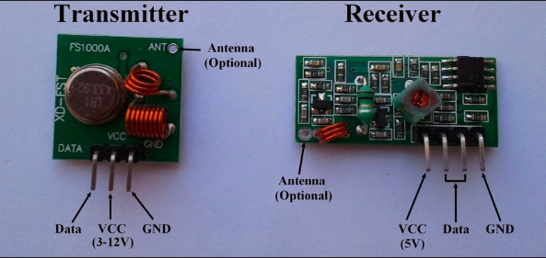
RF Communication
Radio Frequency Communication
It operates at a specific frequency of 433MHz.

Slide 4
RadioHead Library
Install ‘RadioHead’ Library
Sketch -> Include Library -> Manage Libraries
Search for ‘RadioHead’

Slide 5
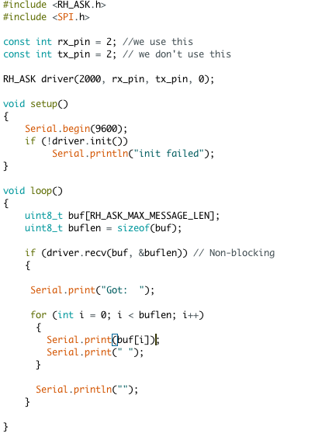
Receiver

Slide 6
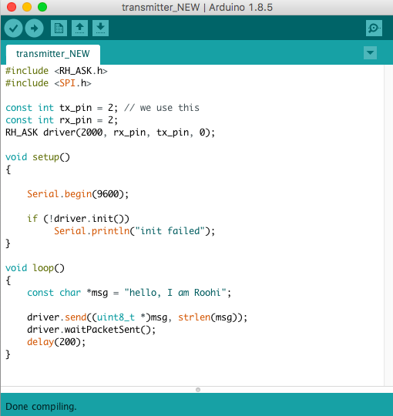
Transmitter

Slide 7
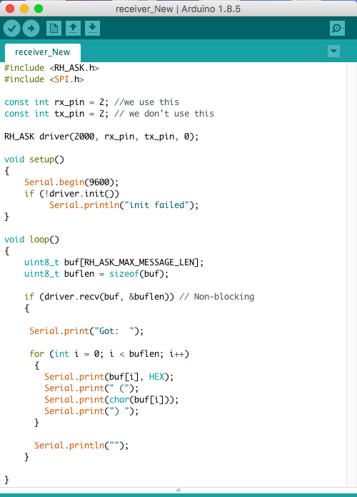
Arduino Code

Slide 8
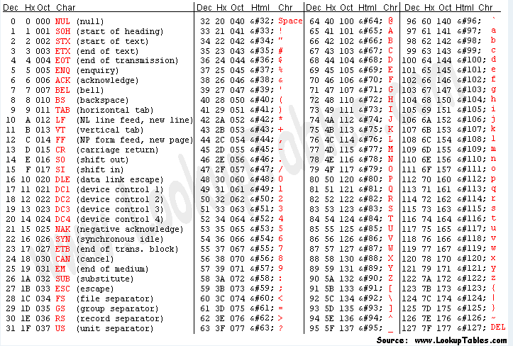
ASCII Characters

Slide 9
How to Control Our Car Using ‘RF’
??

Slide 10
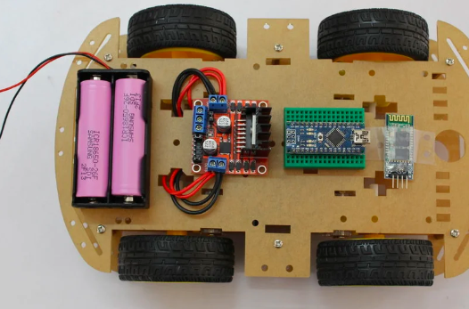
Battery Solution for Our Car
18650 Li-on Battery (2x)
18650 Battery Holder
Battery charger

Slide 11
Publications
Photon – TISB Publication for Physics & Technology -> Find info
EFY (Electronics For You) – efy.in –> Will send by End of October
IET (Institution of Engineering & Technology) – theiet.in -> Getting the info

Slide 12
Projects & Reports
What are the components used
How did we connect them
What communication technology is used to control
Research - Some facts about communication technology we used
Results – how far you can control it from? What are the limitations?

Slide 13
Projects & Reports
Sreshta – Bluetooth & voice controlled car (Android) + report
Ved – BLE (IoS) & autonomous car + report
Krish – IR controlled car + report
Sana – RF controlled car + report

